Slide 1
Operating System
Processing Models & Execution Modes
Serial • Batch • Multiprogramming • Time-Sharing

Slide 2
Evolution of OS Processing Models
Serial
1940s-1950s
Batch
1950s-1960s
Multi-
programming
1960s
Time-
Sharing
1970s+
Key Characteristics:
Model
Resource Type
CPU Util.
I/O Util.
User Interaction
Serial
Single User
Low
Low
None
Batch
Multiple Jobs
Medium
Medium
None
Multiprogramming
Multiple Jobs
High
High
None
Time-Sharing
Multiple Users
Very High
Very High
Yes

Slide 3
Serial Processing (Late 1940s - Mid 1950s)
Historical Context:
No operating systems existed during this period
Programmers interacted directly with hardware
Programs written in machine language
Input via card readers, output via line printers
Display lights indicated error conditions
How Serial Processing Worked:
Programmers reserved machine time on a sign-up sheet
Users accessed computer sequentially (one after another)
After time block finished, next programmer's turn
Output appeared after minutes, hours, or even days
Result: Wasted computer time and low user productivity

Slide 4
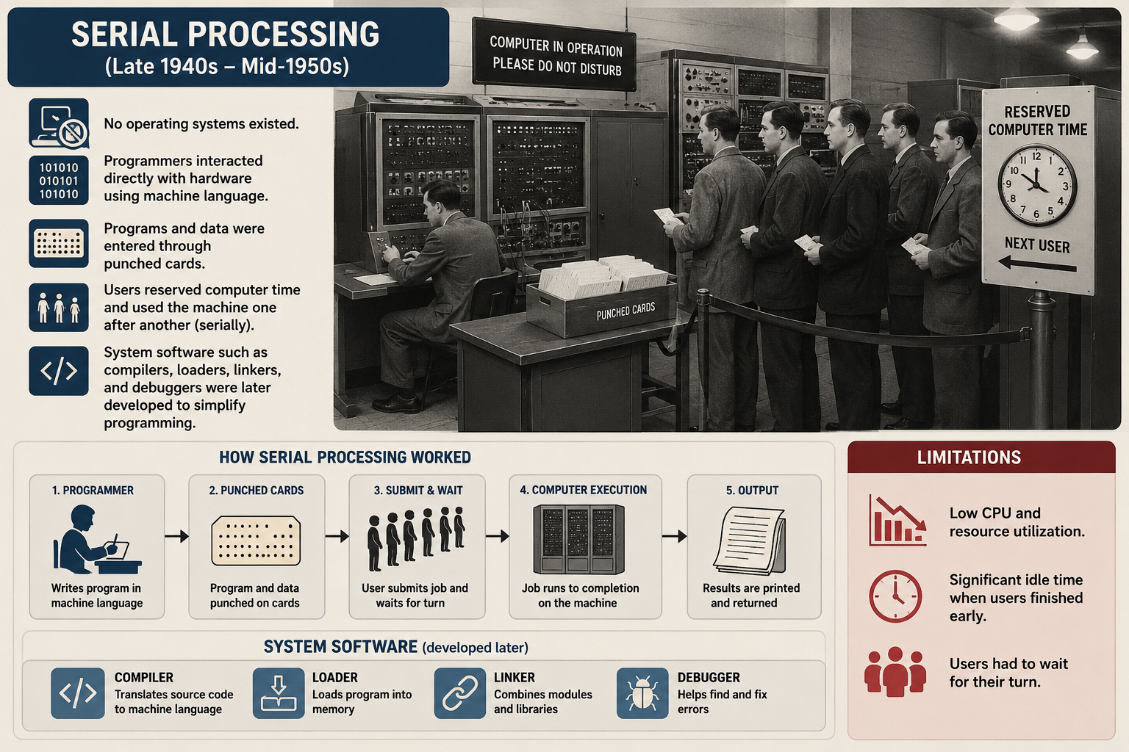

Slide 5
Serial Processing: Problems & Improvements
Main Problem
System Software Tools
Wasted Computer Time
Programmers might book 2 hours but finish in 1.5 hours. No other programmer could use the computer during unused time.
• Language translators
• Loaders & Linkers
• Debuggers
• Library routines
• I/O routines
→
Impact of System Software Tools:
Language Translators (Compilers/Interpreters) - Converted programs from high-level languages to executable code
Loaders - Automated the process of loading executable programs into memory
Debuggers - Detected and examined run-time errors
Linkers - Linked precompiled routines with object code for execution
Result - Made serial processing more efficient, but still had low resource utilization

Slide 6
Batch Processing (Mid 1950s - 1960s)
Historical Context:
Introduction of transistors made computers more reliable- expectation that they would continue to work for a long time
Mainframes generally operated by the professional operators
Computers became expensive and could be afforded only by major corporations and government agencies
First operating system developed by General Motors for IBM 701
Clear separation made between computer operators and programmers
Key Concept:
Jobs with similar requirements are batched together and run one after another
Example: All FORTRAN jobs run together so the compiler is loaded only once
To improve resource utilization and user productivity, the first operating system was developed by General Motors for IBM 701 in the mid-1950s. This operating system was termed as a batch operating system.

Slide 7
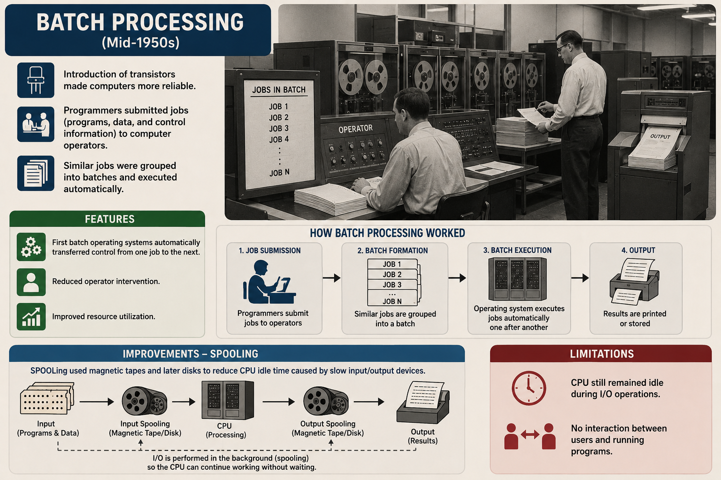

Slide 8
Batch Processing: Memory Layout & Operation
Memory Layout
Batch Monitor Operation:
Batch Monitor
(Kernel)
Reads from card reader and loads first job
JOB_START identifies job beginning
Executes the job
JOB_END identifies job completion
Searches for next job in batch
Repeats until all jobs finished
Waits for next batch from operator
Operator intervention only at batch boundaries
User Job 1
User Job 2
(if needed)
Free Memory
✓ Advantage: Automatic job transitions without operator intervention

Slide 9
Batch Processing: SPOOLing Solution
Problem: Speed Mismatch
Solution: SPOOLing
Simultaneous Peripheral Operation Online
CPU Speed >> I/O Device Speed
CPU much faster than card reader/printer
Result:
• CPU idle waiting for I/O
• Poor resource utilization
Copy jobs from cards → magnetic tape
OS reads from faster tape (not cards)
Output goes to tape → printer later
Reduces CPU idle time
Later: Tapes → Disks (even faster)
Allows direct access to jobs
→

Slide 10
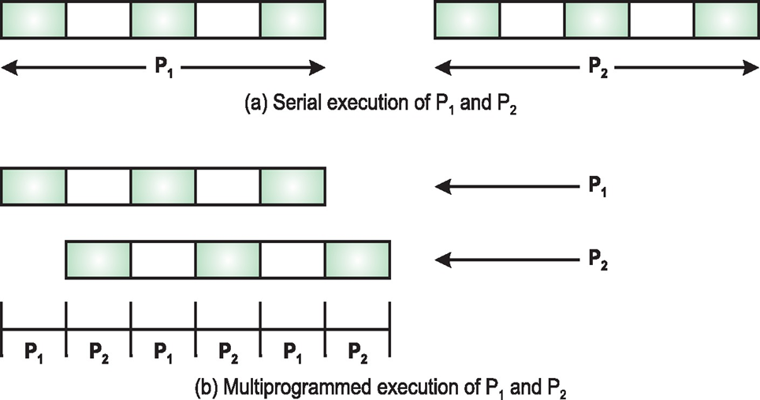
Multiprogramming (1960s - 1970s)
Core Idea:
Allow multiple jobs in memory at same time
When one job does I/O, CPU executes another job
Problem & Solution:
Batch Problem:
Multiprogramming Solution:
Job P1 needs CPU then I/O alternately. CPU idle during P1's I/O even if P2 ready to run.
Multiple jobs in memory. If P1 does I/O, execute P2. Always have work for CPU.
✓ Result: CPU never idle as long as one job ready to execute

Slide 11
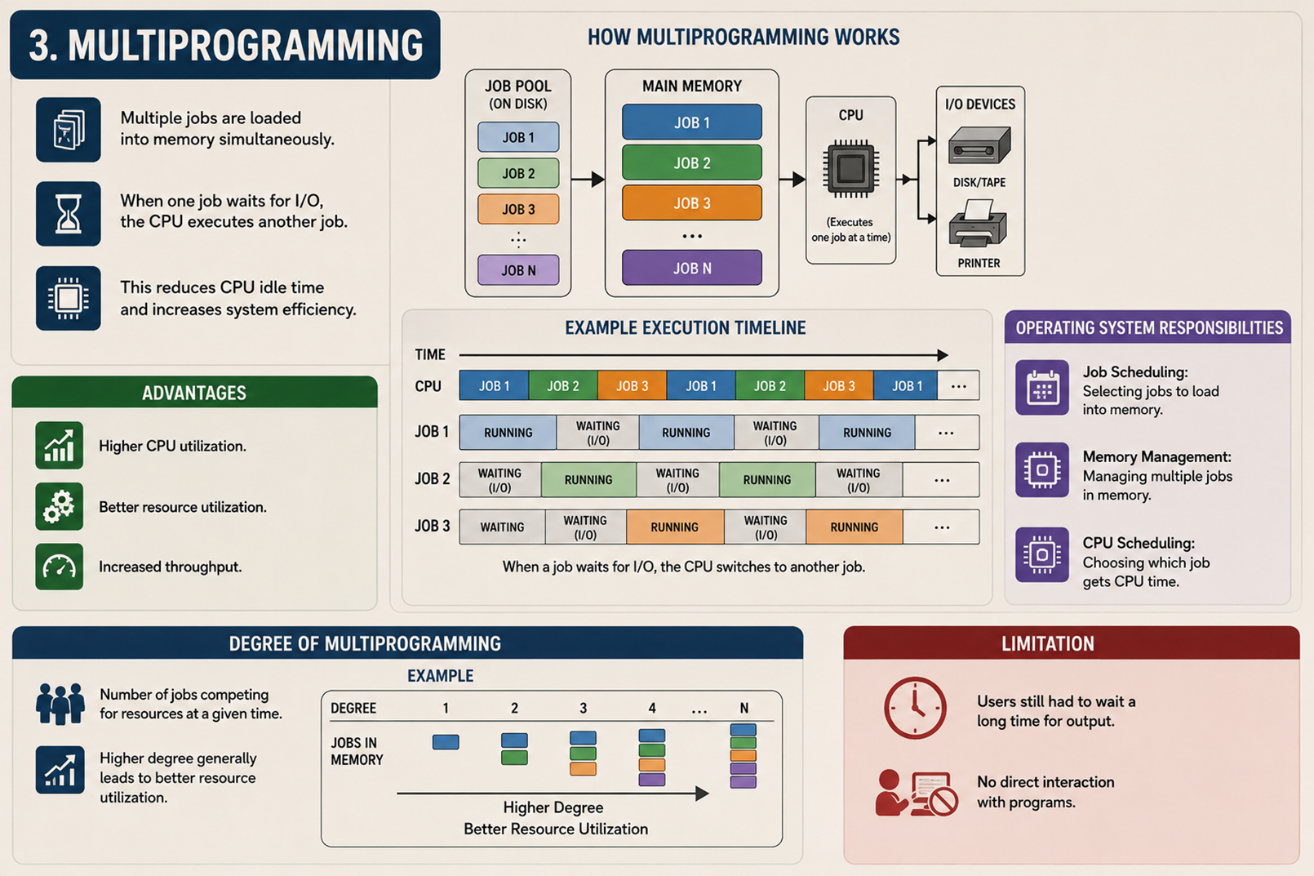

Slide 12
Multiprogramming: Memory Layout & Execution
Memory Layout
Key Concepts:
OS Kernel
Degree of Multiprogramming - Number of jobs competing for resources
Higher degree → Better resource utilization
Job Scheduling - OS selects which job to load to memory
CPU Scheduling - OS chooses which ready job gets CPU
Memory Management - Divide memory into partitions
Concurrent Execution - Multiple processes execute interleaved
Job P1
Job P2
Job P3
Free Memory
Drawbacks:
programmers have to wait for several hours to get their output.
Do not allow programmers to interact with the system.

Slide 13
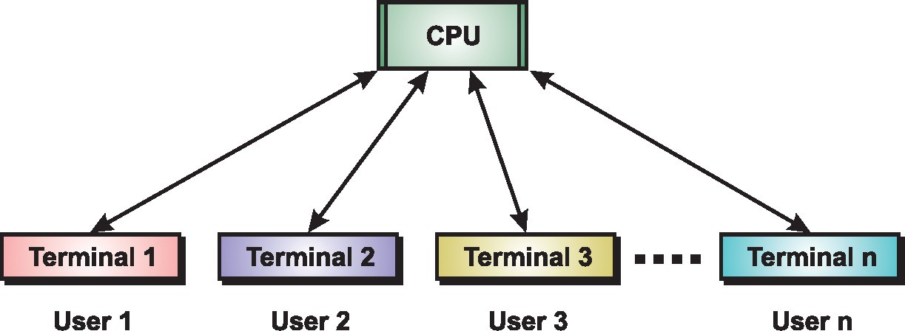
Time-Sharing (Multitasking) Systems
What is Time-Sharing?
Extension of multiprogramming systems
Multiple users interact with system simultaneously via terminals
Each user assigned fixed time-slot
Users give instructions via keyboard/mouse
System response time ~1 second
CPU switches rapidly between users
Each user feels they have dedicated system
Key Advantage of Time-Sharing:
Interactive Programming Environment with quick feedback (unlike batch processing's long turnaround)

Slide 14
Comparison of Processing Models
Aspect
Serial
Batch
Multiprogramming
Time-Sharing
Time Period
1940s-50s
1950s-60s
1960s-70s
1970s+
Users/Jobs
1 user
Multiple jobs
Multiple jobs
Multiple users
Interaction
None
None
None
Interactive
CPU Util.
Very Low
Medium
High
Very High
Response
Hours/Days
Minutes/Hours
Minutes
~1 second
Main Goal
Simplicity
Efficiency
Max CPU use
User convenience
Evolution Pattern: Serial → Batch → Multiprogramming → Time-Sharing
Each model improved resource utilization, user interaction, and system responsiveness. Modern systems use time-sharing with advanced CPU scheduling, memory management, and security.

Slide 15
Key Takeaways
Serial Processing: Direct hardware access, massive resource waste
Batch Processing: Grouped jobs, automatic transitions, SPOOLing for faster I/O
Multiprogramming: Multiple jobs in memory, concurrent execution, CPU never idle
Time-Sharing: Interactive multiple users, rapid CPU switching, ~1 second response
Modern OS: Time-sharing foundation with advanced scheduling, memory, and security mechanisms

